Slide 1
SQL
LESSON 1

Slide 2


Slide 3
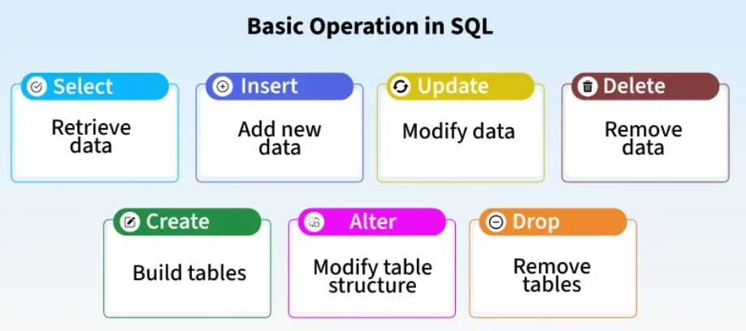

Slide 4
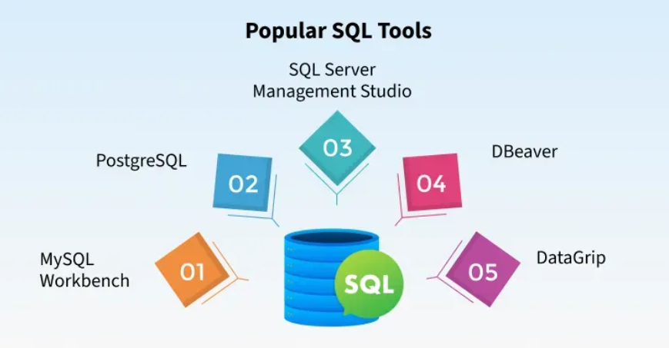

Slide 5


Slide 6


Slide 7
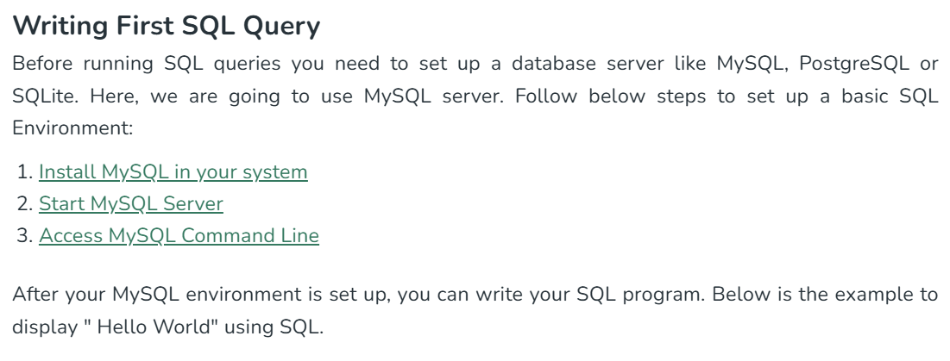

Slide 8



Slide 9


Slide 10


Slide 11
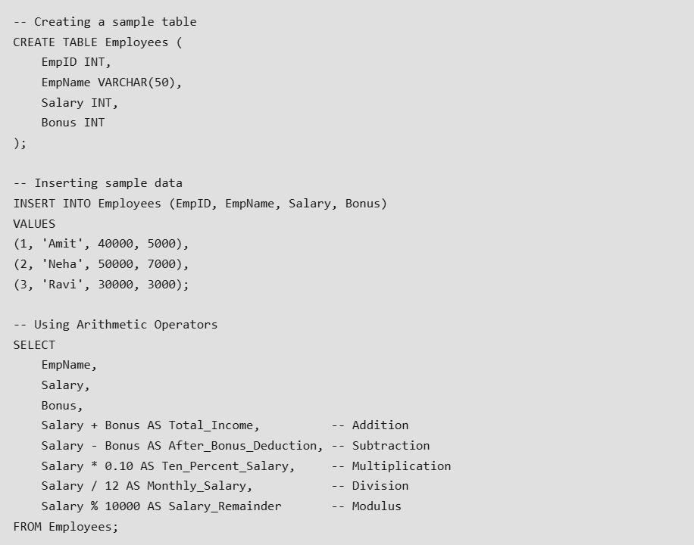

Slide 12


Slide 13
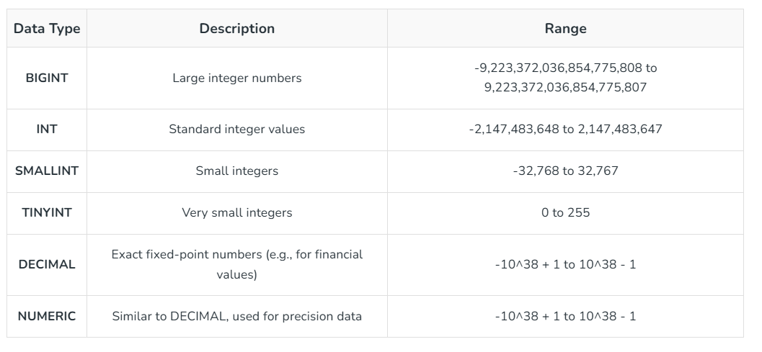

Slide 14
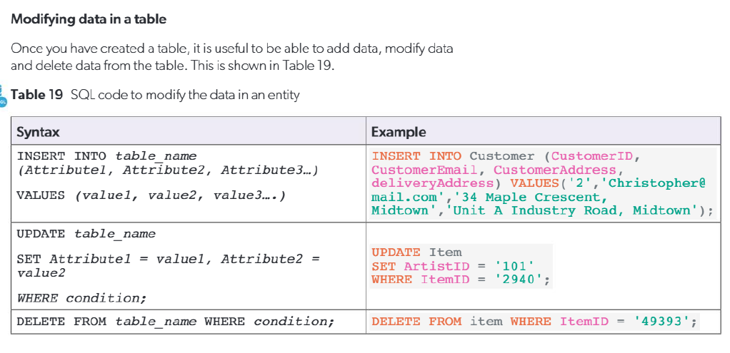

Slide 15
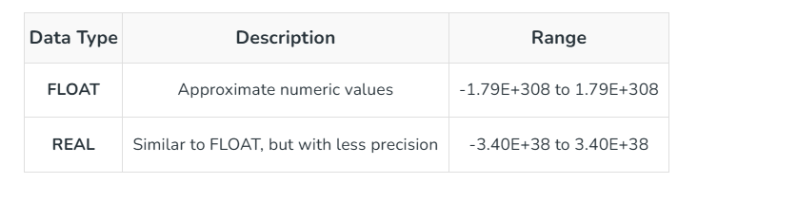
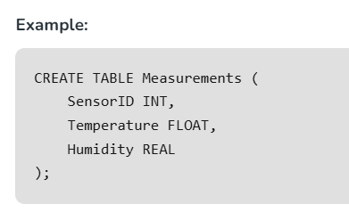
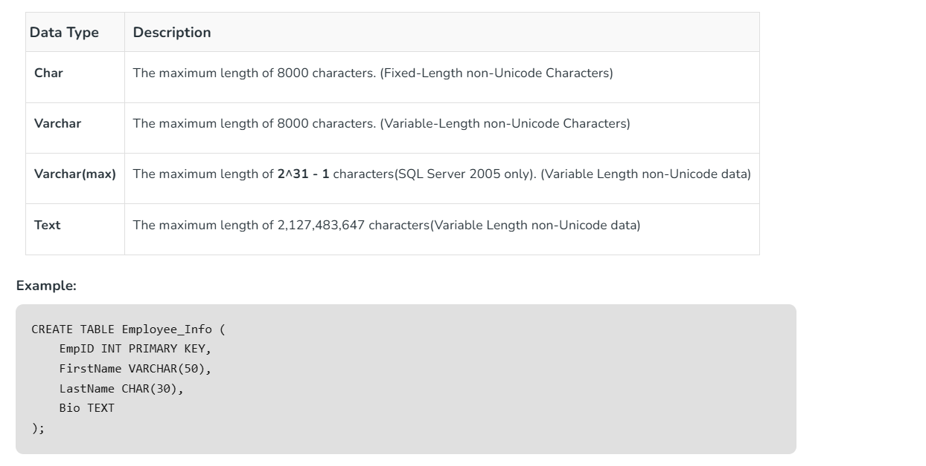

Slide 17
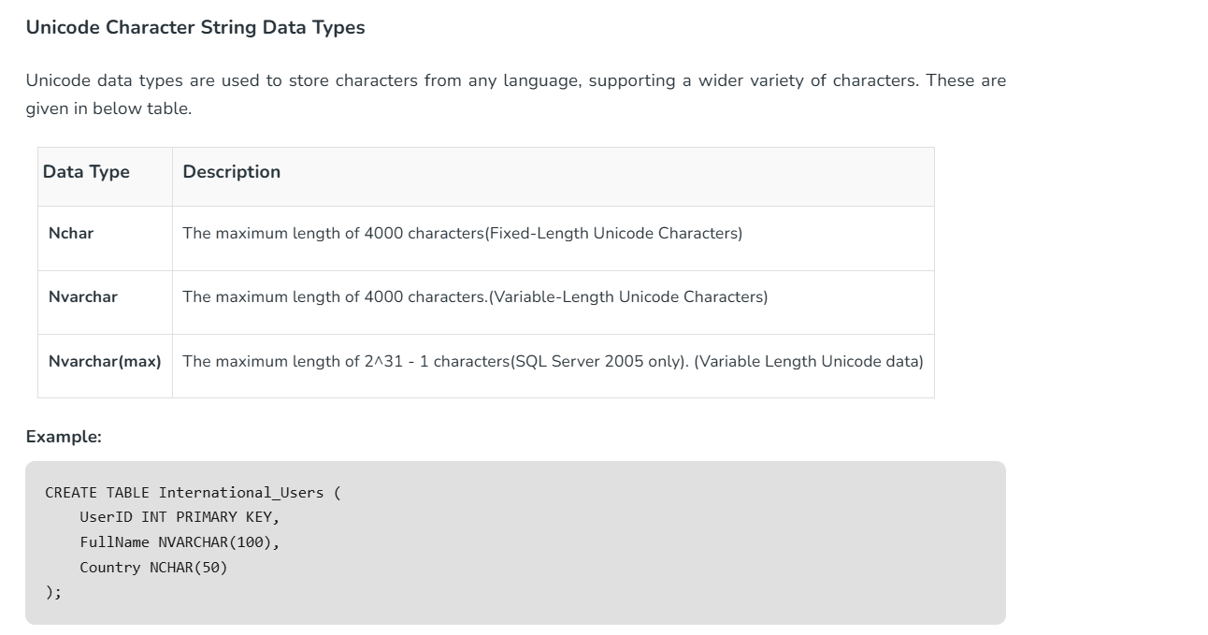

Slide 18
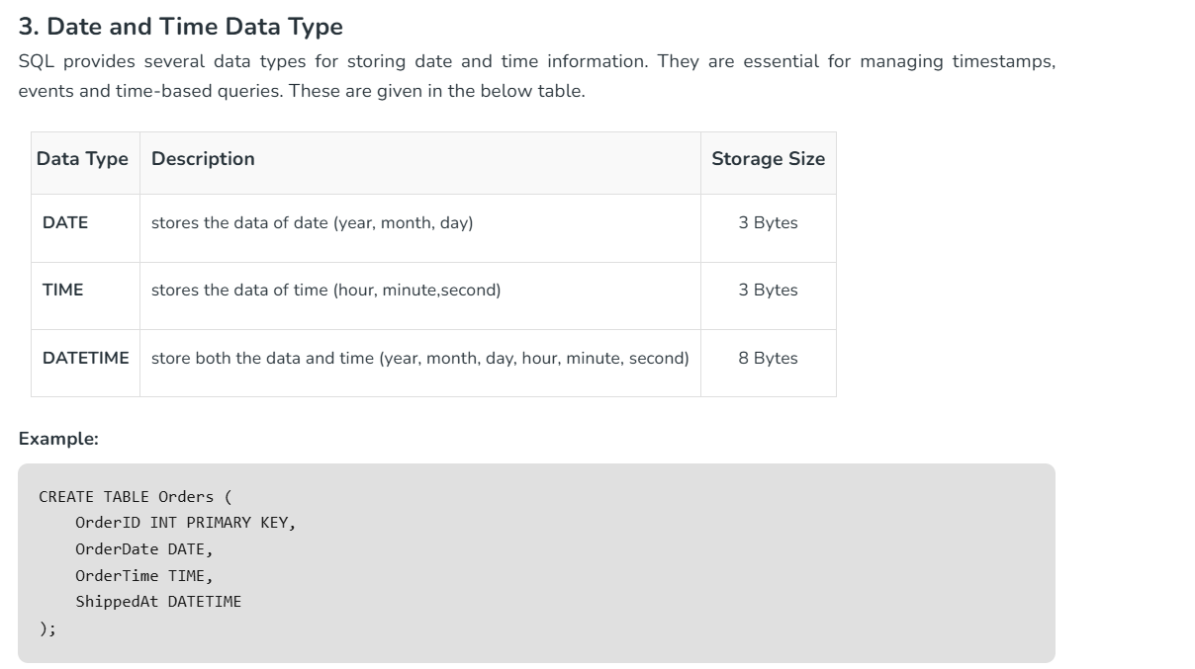

Slide 19
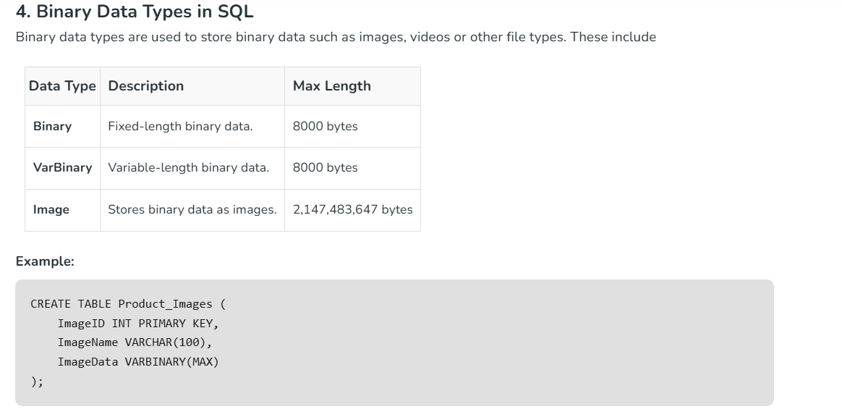

Slide 20
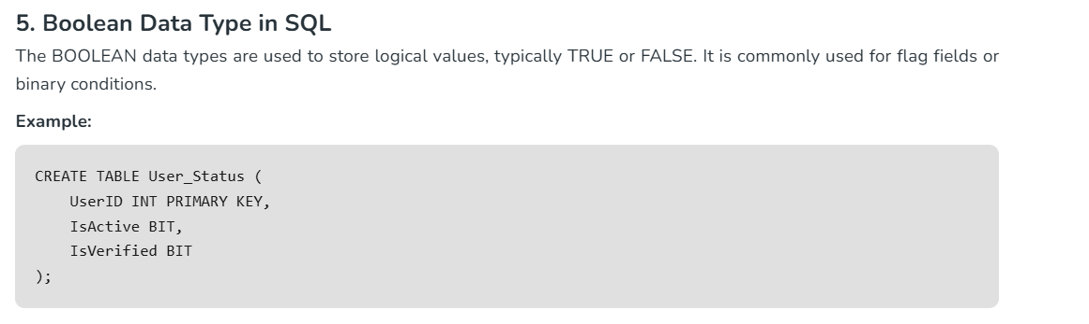

Slide 21
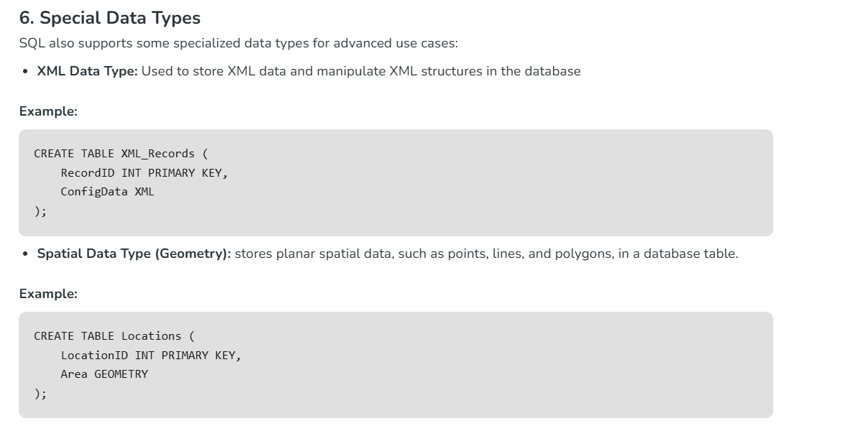

Slide 22
Creating Database
To create a new database in SQL, we use CREATE DATABASE command followed by the database name. Database names cannot contain spaces; if needed, an underscore (_) can be used instead.
Syntax:
CREATE DATABASE database_name;
Let’s create a simple database called GeeksForGeeks
Query:
CREATE DATABASE CS Diploma;

Slide 23
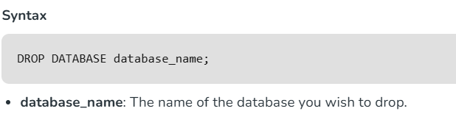
What is SQL DROP DATABASE?
The DROP DATABASE command in SQL is used to completely delete a database and all of its objects, such as tables, indexes, views, and other dependent objects. Once executed, this operation cannot be undone, so it's crucial to back up the database before performing this action.
This command is typically used in scenarios where a database is no longer required or needs to be removed for reorganization. Before running the command, ensure that we have appropriate permissions to drop the database, as only database administrators typically have the necessary rights.
Purpose: To remove a database from the DBMS permanently.
Outcome: All data, schema, and database objects are erased.

Slide 24
Deleting a Database
If you ever want to delete a database, use:
Query:
DROP DATABASE Computer Science diploma ;

Slide 25
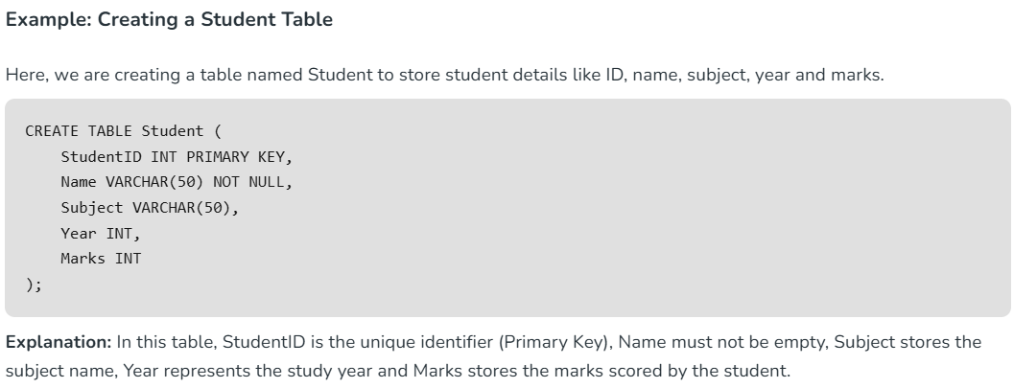
Creating Tables
A table is the core structure of a database where data is stored in rows and columns. While creating a table, you must define:
Column names
Data types (e.g., INT, VARCHAR, DATE)
Constraints (e.g., PRIMARY KEY, NOT NULL, UNIQUE, DEFAULT, FOREIGN KEY)
Syntax:
CREATE TABLE table_name (
column1 datatype constraint,
column2 datatype constraint,
...
);

Slide 26
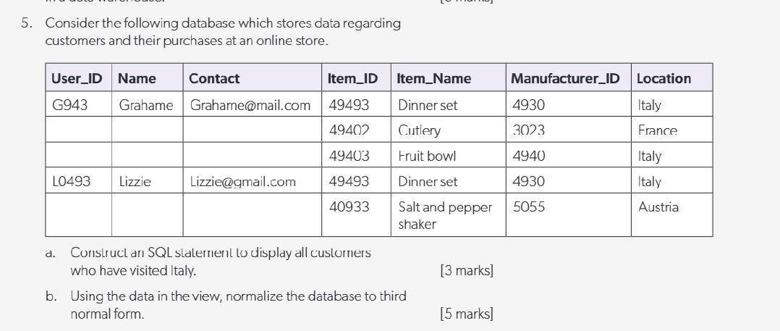

Slide 27
A3.3.2 Construct queries between two tables in SQL

Slide 28
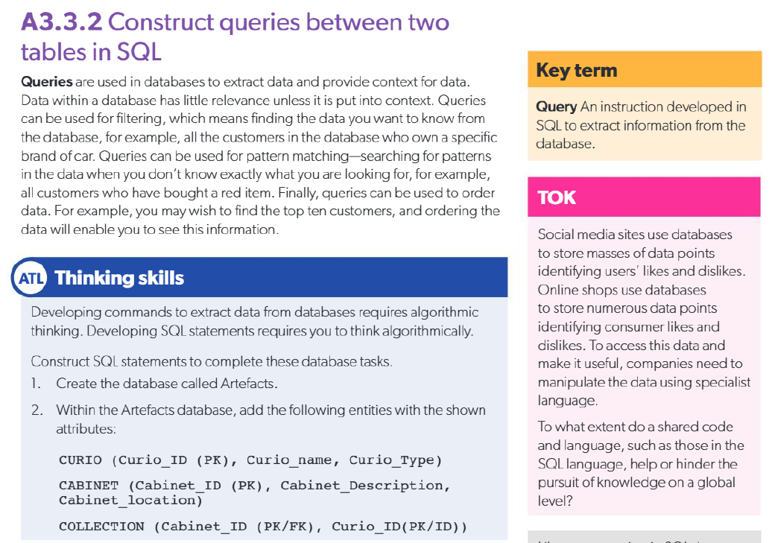

Slide 29
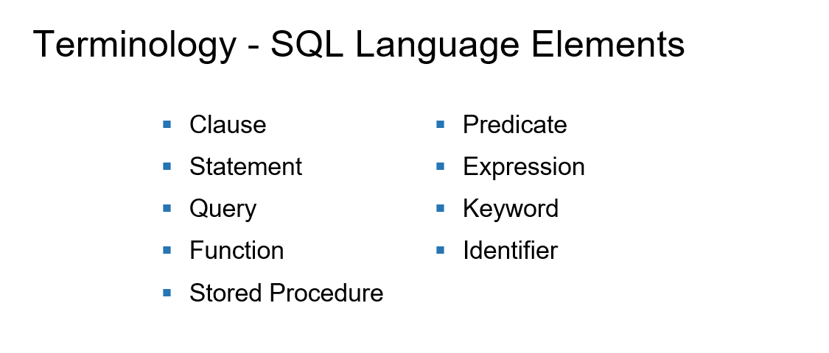

Slide 30
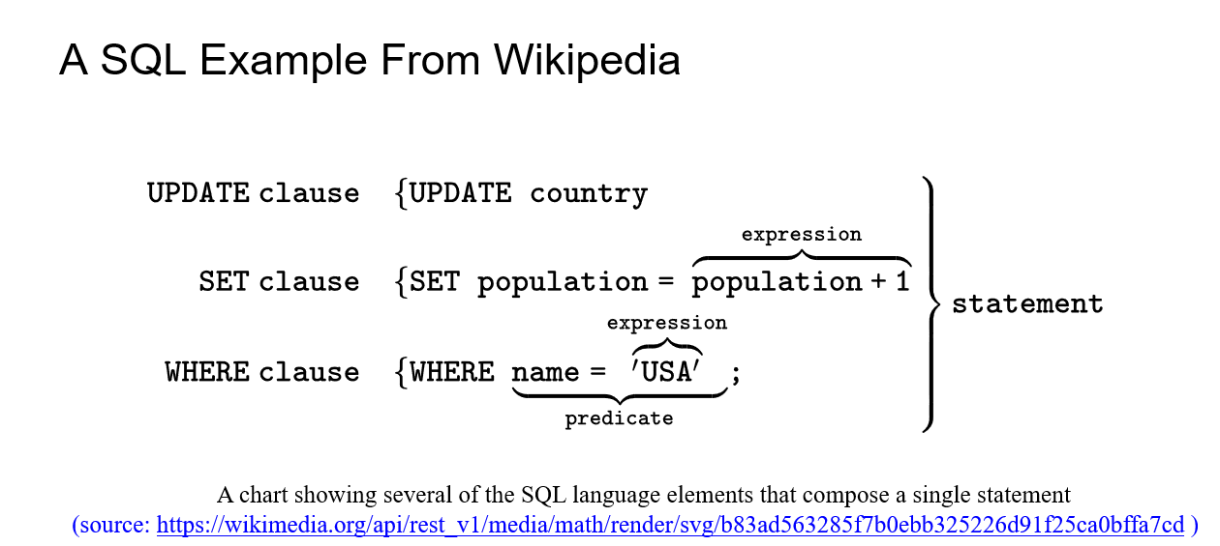

Slide 31
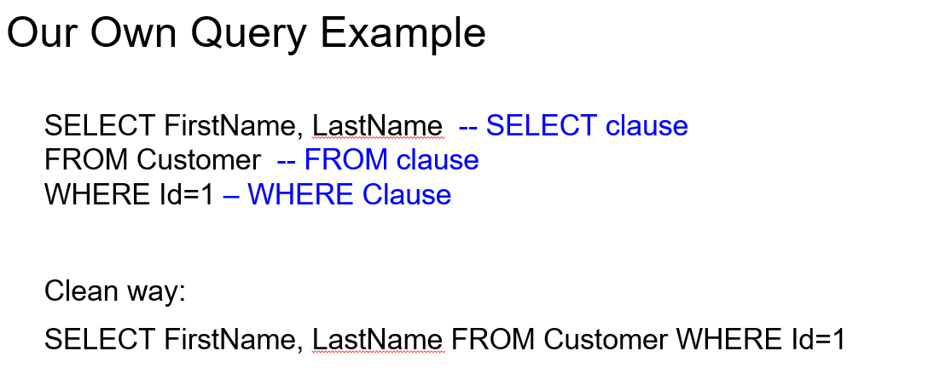

Slide 32
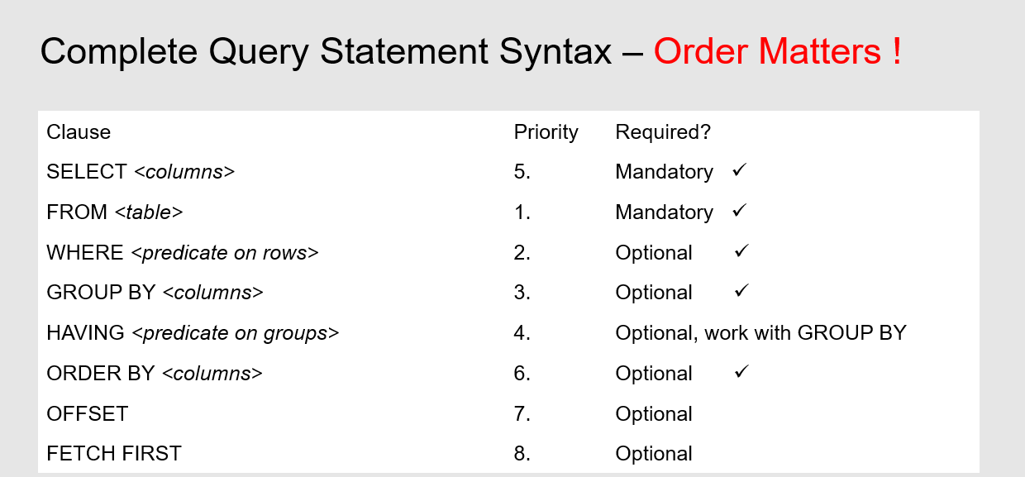

Slide 33
